Slide 1



Parking Management System
Project Title: "Parking Management System"
Member Names: Naman Upadhyay
Akshat Upadhyay
Anjali Desai
Ayush.K.Giri
Course and Institution: OOPS WITH C++ SRM UNIVERSITY AP
Date of Presentation: November 2024
Faculty Advisor: Kavitha Rani Karnena
Notes:
1

Slide 2
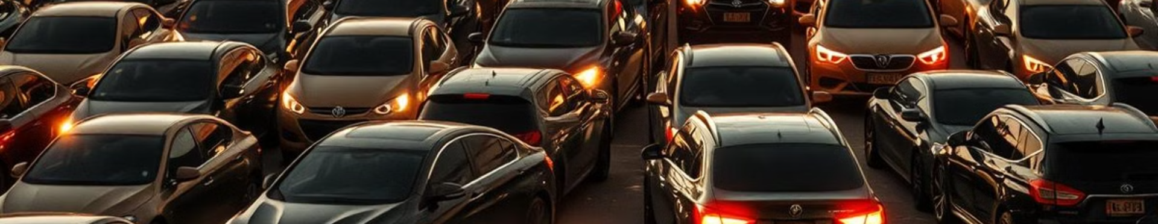
The Problem: Inefficient Parking
1
Limited Parking
2
Time Waste
3
Increased Pollution
Limited parking spaces can lead to frustration for drivers and create traffic congestion.
Drivers waste valuable time searching for available parking spots, impacting productivity and convenience.
Cars idling while searching for parking contribute to air pollution and increase traffic congestion.
Notes:
2

Slide 3
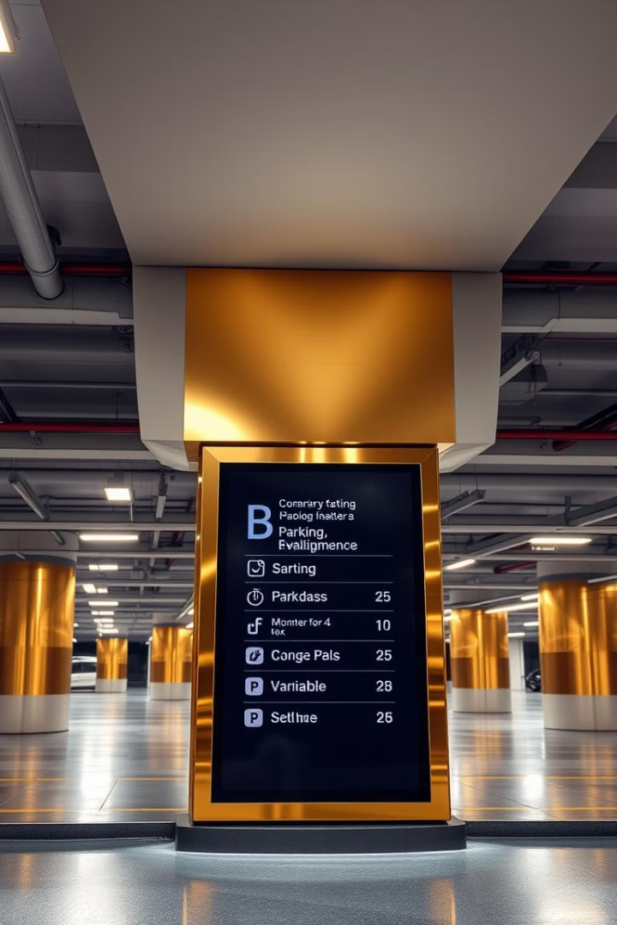
Benefits of Automated Parking Management
Improved Parking Availability
Enhanced Parking Efficiency
Real-time occupancy data helps drivers find available spots quickly, reducing search time and frustration.
Automated systems optimize parking space utilization, maximizing revenue and minimizing congestion.
Reduced Environmental Impact
By streamlining parking processes, automated systems minimize car idling and contribute to reduced air pollution.
Notes:
3

Slide 4
INTRODUCTION
1
Project Description
2
Problem Statement
3
Relevance
A console-based parking management system with administrative and user functionalities.
Managing large parking spaces efficiently can be challenging without automation. This system aims to solve parking congestion and manual record-keeping inefficiencies.
Helps optimize parking space utilization, reduces the time for slot finding, and provides detailed records.
Notes:
4

Slide 5
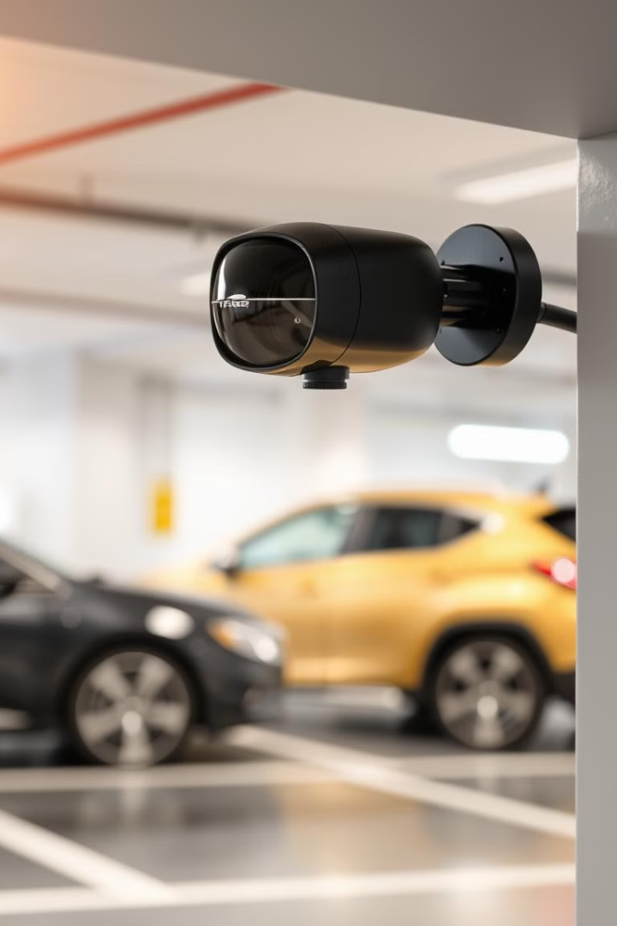
OBJECTIVES
1
Objective
To create an efficient and user-friendly parking management system.
2
Specific Goals
1. Ensure secure access for administrators and users.
2. Automate parking slot assignment, fee calculation, and record management.
3. Provide visual parking maps for users and admin
Notes:
5

Slide 6
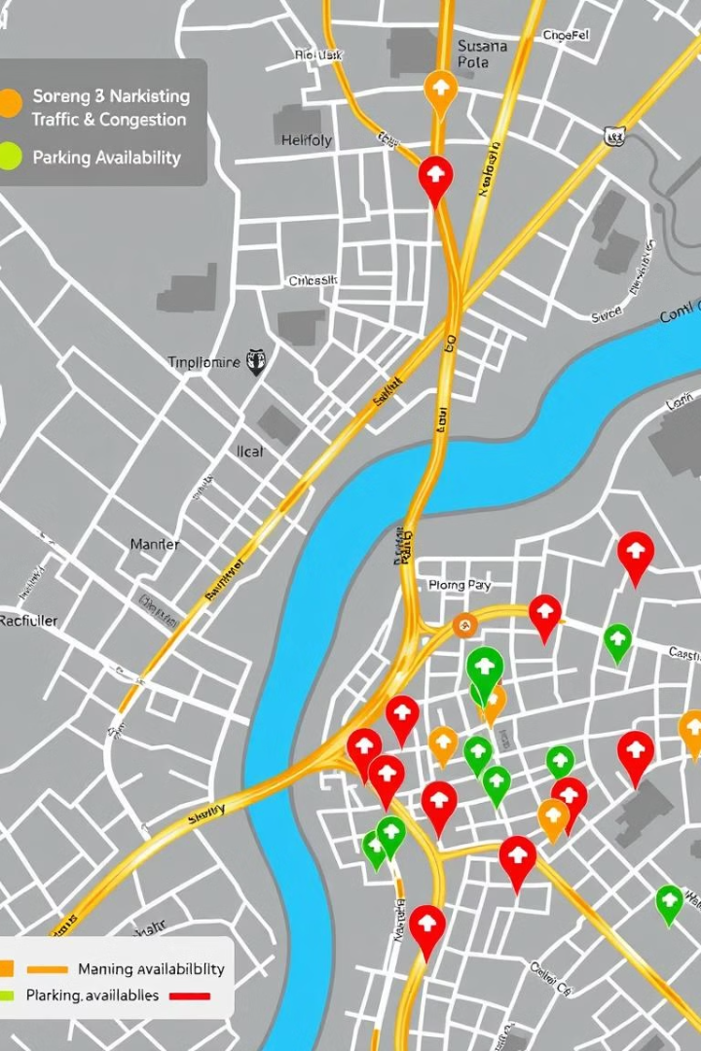
METHODOLOGY
Tools and Languages: Developed in C++ using standard libraries.
1
Authentication System: Secures access for "Admin" and "User" roles.
File System: Records car details, parking slots, and expenses in text files (carparkdb.txt and carparkexpensedb.txt).
Slot Assignment Logic: Automates assignment based on slot availability.
Notes:
6

Slide 7
IMPLEMENTATION
System Architecture:
Login Module: Validates user credentials and assigns roles.
Parking Management:
Car Details: Collects and stores driver, car details, and stay duration.
Slot Management: Assigns available slots dynamically.
Expense Calculation: Calculates fees based on stay duration.
Workflow Diagram:
User chooses role -> Login -> Parking options -> View/remove car, see map, check expenses, etc.
1
Vertical Parking Garages
2
Parking as a Service
Multi-level parking structures maximize space utilization in urban environments, addressing limited parking availability.
Subscription-based parking services will offer flexible and convenient parking options, tailored to individual needs.
Notes:
7

Slide 8
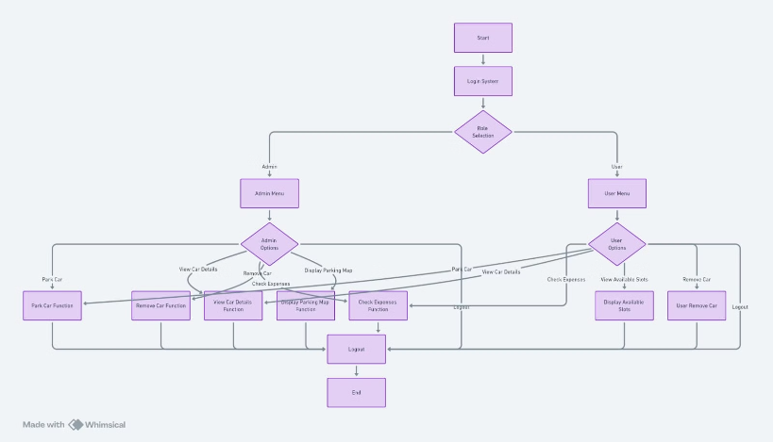
Main flow chart
Notes:
8

Slide 9
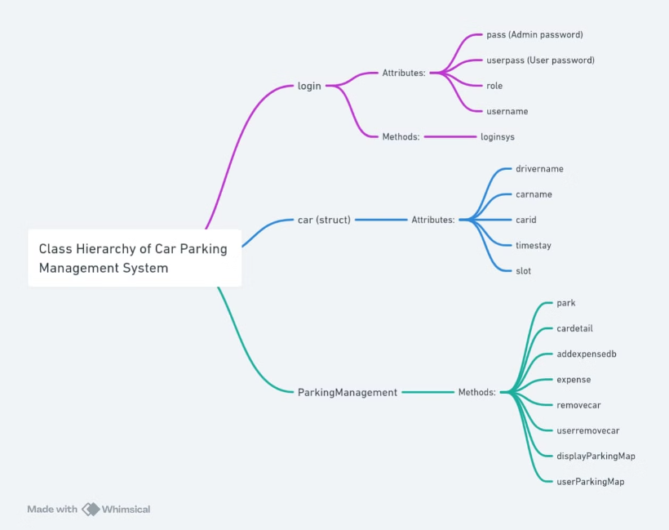
Main Class Hierarchy Class Data Members And Member Functions
Notes:
9

Slide 10
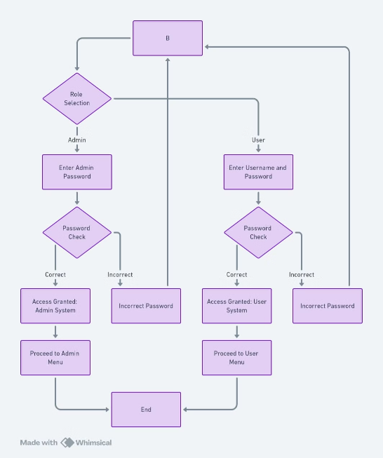
Login System Flowchart
Notes:
10

Slide 11
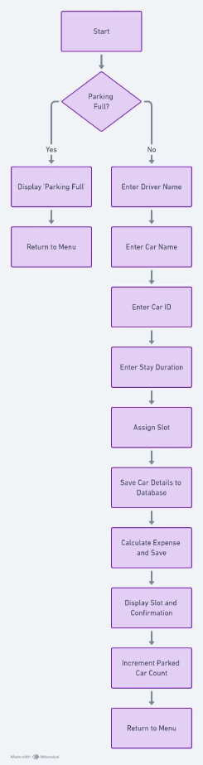
Park Car Module Flowchart
Notes:
11

Slide 12
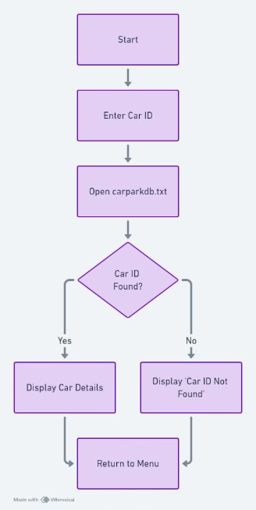
View Car Details Module Flowchart
Notes:
12

Slide 13
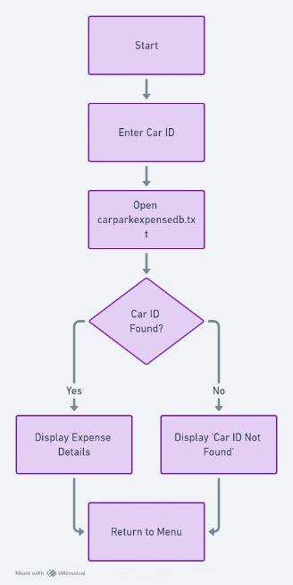
Check Parking Expenses Module Flowchart
Notes:
13

Slide 14
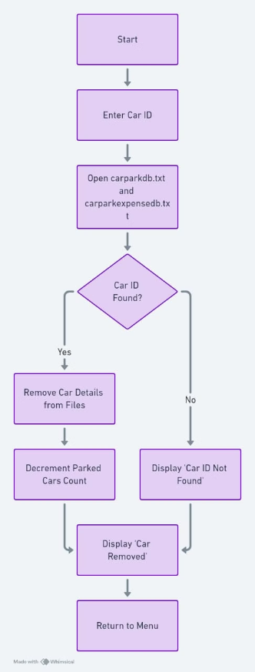
Remove Car Module Flowchart
Notes:
14

Slide 15
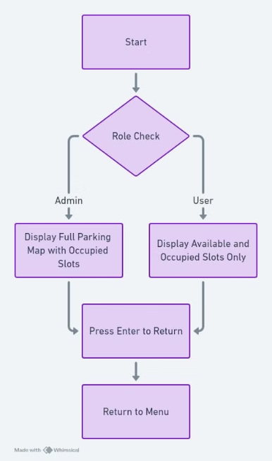
Display Parking map Module Flowchart
Notes:
15

Slide 16
RESULTS
System Output:
Successful slot assignments and updates for parked cars.
Accurate fee calculation based on stay hours.
Visual representation of parking slot availability.
Data Visualization:
Text Outputs: Show parking slots with "X" for occupied and slot codes for available.
Parking Expense Summary: Recorded expenses stored for easy retrieval.
Notes:
16

Slide 17
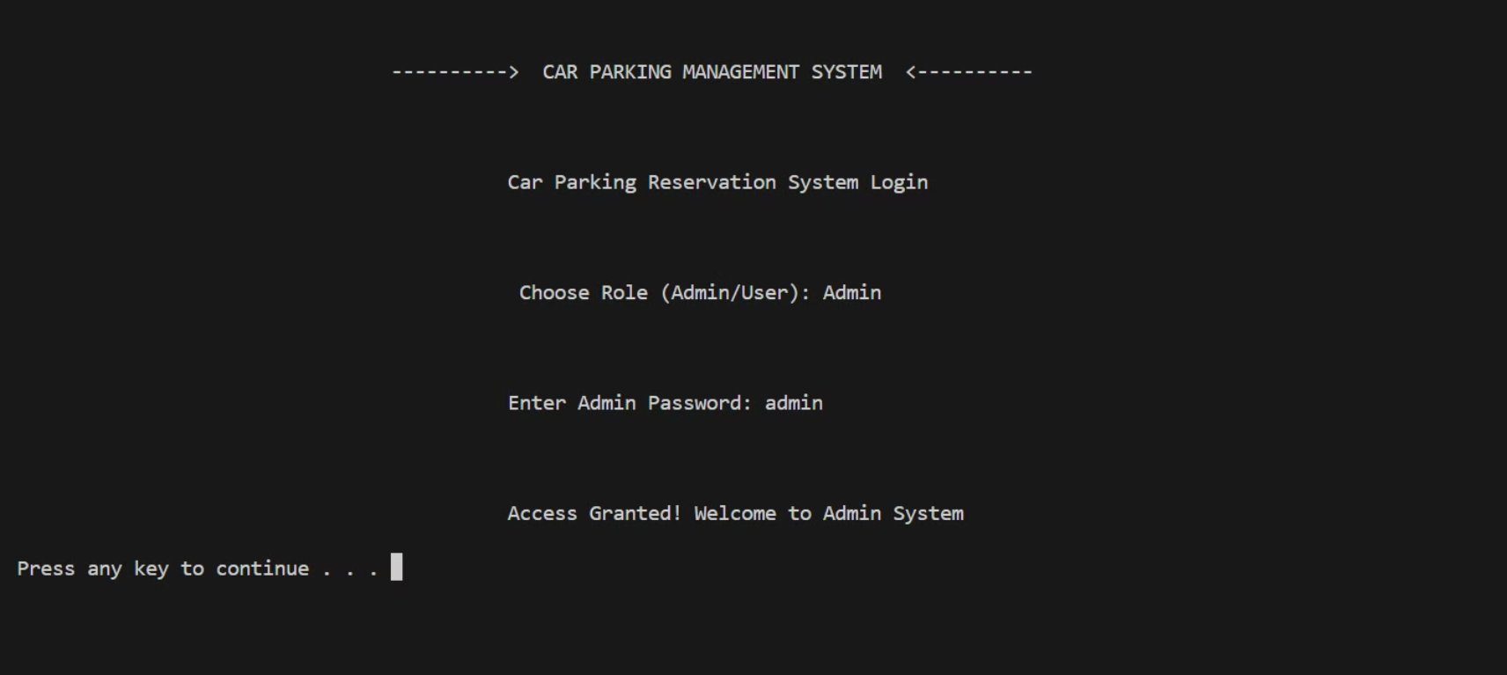
Login Interface
Notes:
17

Slide 18
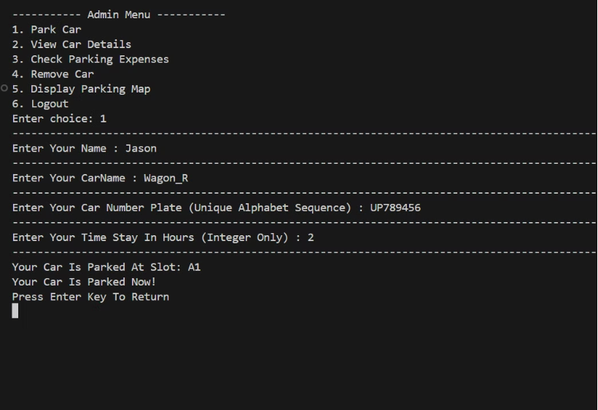
Parking the car
Notes:
18

Slide 19
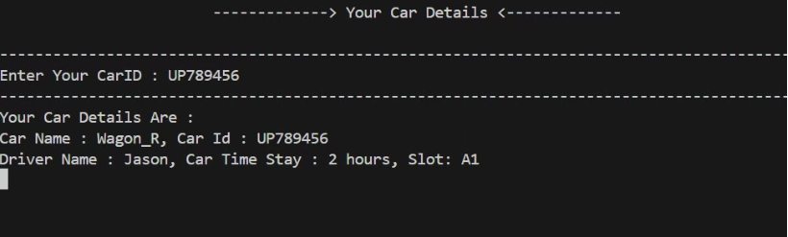
Viewing Car Details
Notes:
19

Slide 20
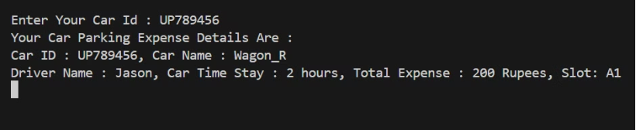
Check Parking Expenses
Notes:
20

Slide 21
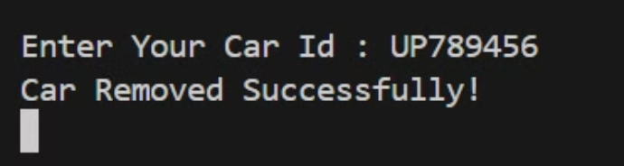
Remove Car
Notes:
21

Slide 22
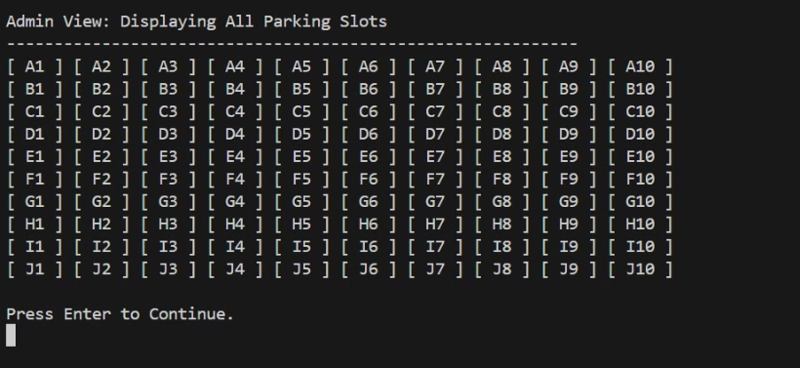
Display Parking Map
Notes:
22

Slide 23
CONCLUSION
Summary: This project efficiently handles parking management with role-specific access, automated slot allocation, and expense tracking.
Significance: Reduces manual tasks, improves parking efficiency, and ensures accurate record-keeping.
Notes:
23

Slide 24
FUTURE WORK
Enhancements:
Integrate a graphical user interface for better user experience.
Add a real-time display of parking slots using a database.
Implement user notifications for parking status and duration updates.
Integration with AI and IoT for smart and automatic parking system . Further with usage of ML we can implement variable parking charges based on peak hours and congestion
Notes:
24

Slide 25
THANK YOU
ASK US IF THERE ARE ANY QUESTIONS
Notes:
25

